Slide 1
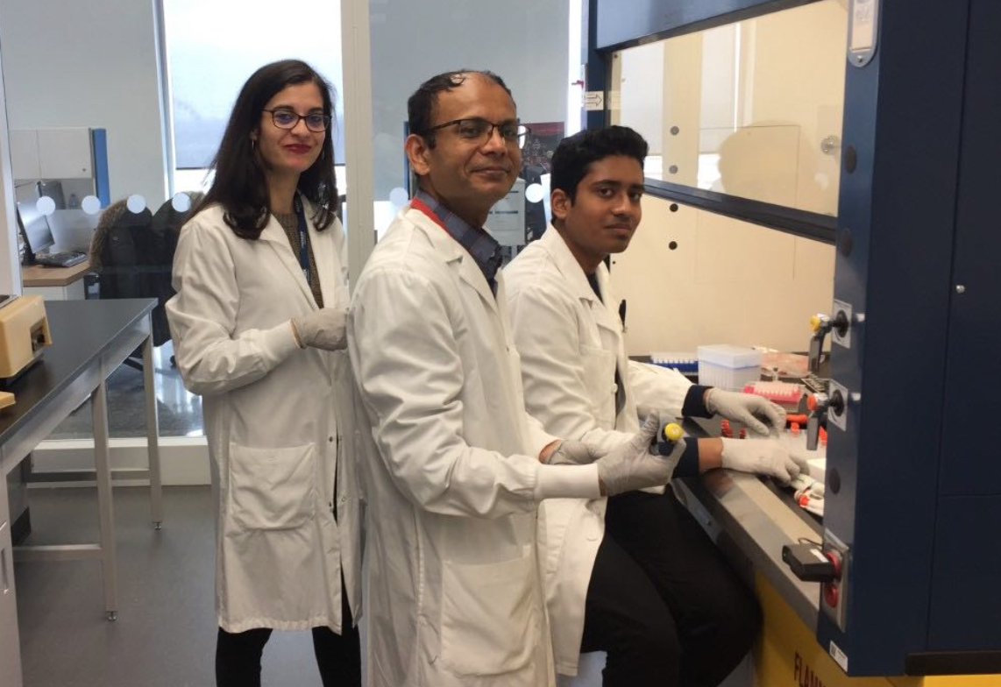
Effect of ART in reducing fungal translocation in HIV-infected patients
J.P. Routy¹, V. Mehraj^{1,}, R. Ramendra^{1,}, C. Costiniuk^{1,}, B. Lebouché^{1,}, J. Chen^{1,} , R. Ponte^{1,}, R. Thomas³, B Trottier⁴, J Szabo¹,³, P. Coté⁴, R. LeBlanc⁵, J-G Baril⁴, N. Bernard^{1,} D. Sheppard^{1,} M. C Chartrand-Levebvre², M El-Far², M Durand², H Lu¹, C. Tremblay², for the Montreal Primary HIV-infection and Canadian HIV and Aging Cohort Study Group
1. Chronic Viral Illness Service and Research Institute, McGill University Health Centre
2. Department of Microbiology and Immunology and Centre Hospitalier de l’Université de Montréal
3. Clinique Médicale l'Actuel
4. Clinique Médicale Quartier Latin
5. Clinique Médicale OPUS,
All centres are in Montréal, QC, Canada
V. Mehraj,,
R. Ramendra
We are very thankful to all study participants

Slide 2
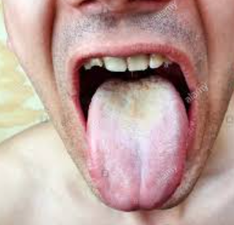
Search for a marker of fungal translocation
LPS and sCD14 are validated markers of bacterial translocation
(1→3)-β-D-glucan (βDG) is a major component of most fungal cell walls and released during fungal-growth and in tissue invasion process
βDG represents a soluble the presumptive diagnosis of invasive fungal infection including during HIV infection (PJP)¹
βDG has been considered as a marker of inflammation, neurocognitive dysfunction, and fungal translocation marker in HIV patients not having fungal infection^{2,3,4}
However, the contribution of ART in improving βDG as fungal translocation marker remains to be determined
We assessed the role of ART on βDG plasma levels when initiated during early (EHI) and chronic HIV infection (CHI) in absence of fungal infection
Candida albicans colonisation
1) Farhour Z, Routy et al. Mycoses 2018. 2) Morris A, et al. J Acquir Immune Defic Syndr 2012
3) Hoenigl M, et al. GMS Infect Dis 2015; Medicine (Baltimore) 2016; Front Immunol 2016, CROI 2018
4) Panpetch W et al. Shock 2018

Slide 3
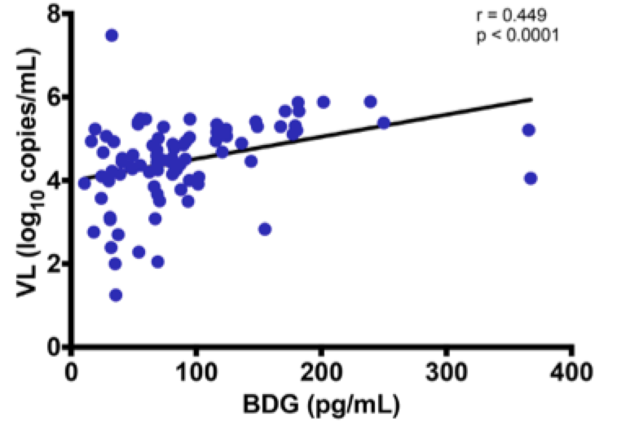
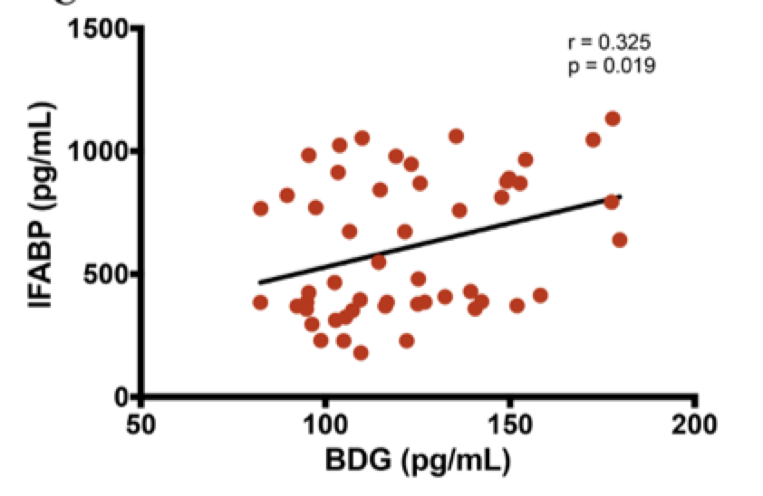
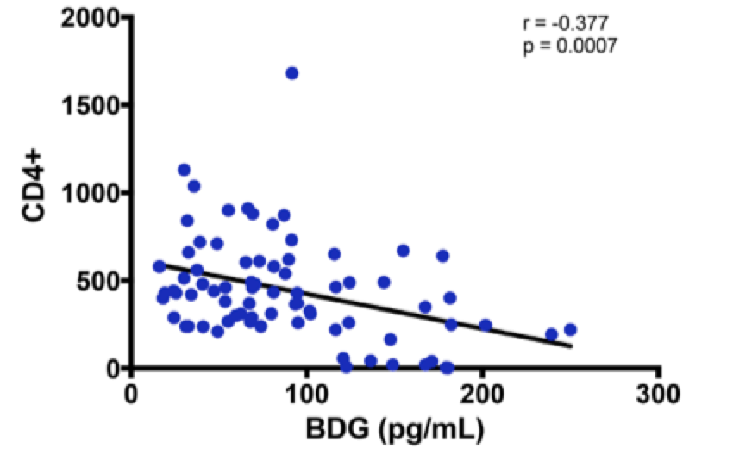
Correlations between CD4, viral load, I-FABP and βDG
Participants not having O.I., cancer or colitis
From Montreal PHI study group and the Canadian HIV and aging cohort
Marker of Epithelial Gut Damage: I-FABP
Only participants not receiving ART
Participants in chronic infection
No correlation during EHI
Plasma levels of βDG were quantified using Fungitell® assay
Plasma galactomannan levels were quantified using the Platelia™ assay to confirm the absence of Aspergillus infection

Slide 4
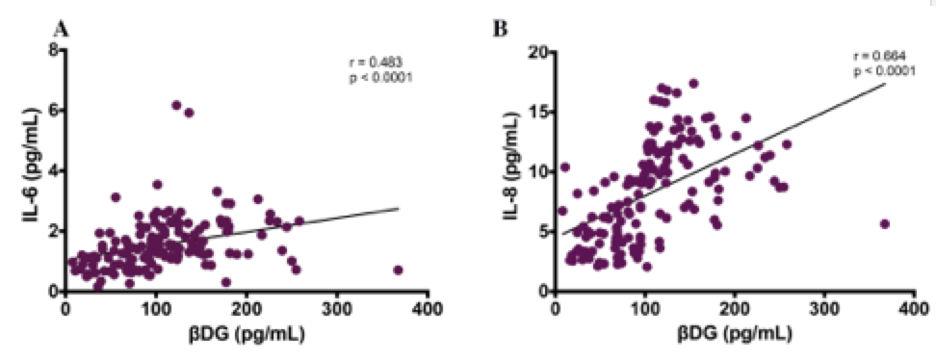
Correlations between LPS, sCD14, IL-6, IL-8 and βDG
Bacterial translocation markers
Systemic activation markers
Absence of correlation with IL-1β and TNF-α

Slide 5
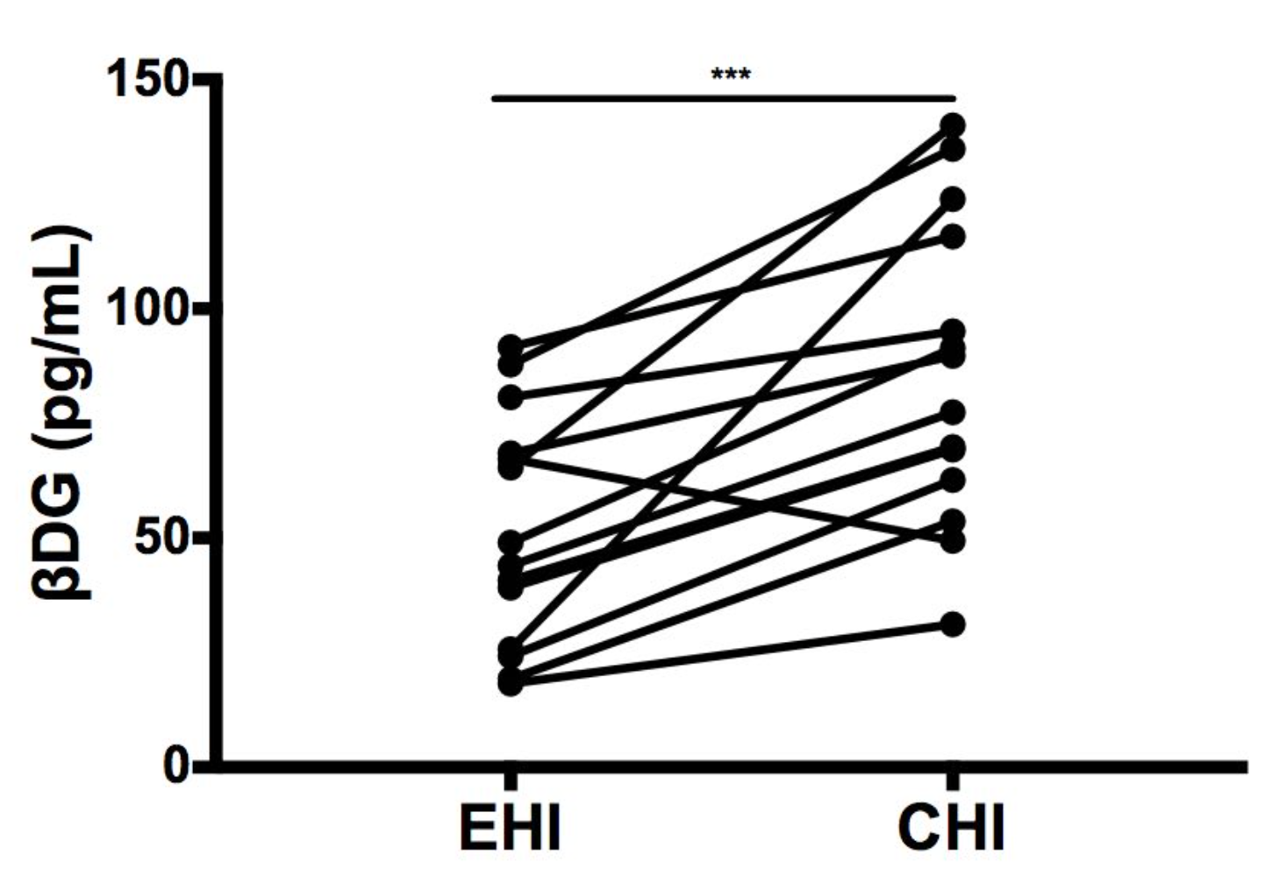
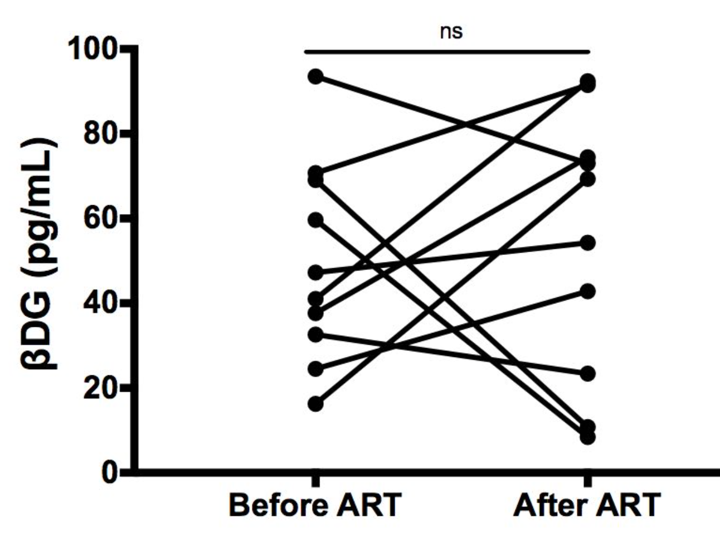
Effect of ART on βDG and LPS during early and chronic phases of HIV infection
No ART
ART+
BDG levels increase over 2 years
ART does normalize BDG levels
ART
LPS: Lipopolysaccharides
ART
Prospective evaluation
Galactomannan levels were not different from UC in all HIV-infected groups

Slide 6
Conclusion
βDG is elevated during early and chronic HIV-infection
Represents a new plasma biomarker of systemic immune activation
ART In early infection:
Prevents levels to further increase without normalization
ART in chronic infection:
Does not change plasma levels of βDG
For future direction, we will have to determine whether or not
βDG is “just another marker” or an independent player in HIV pathogenesis

